Slide 2
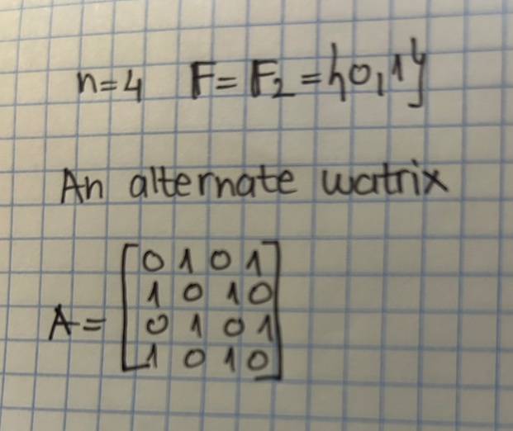
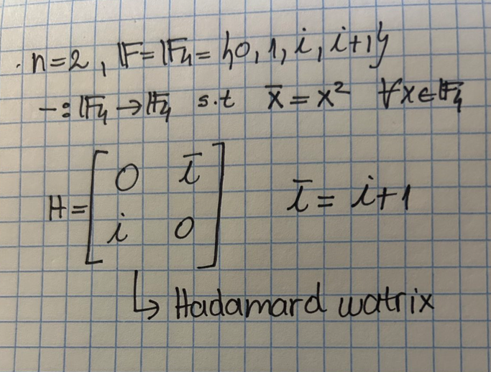

Slide 5
What if my determinant is not zero?

Slide 6
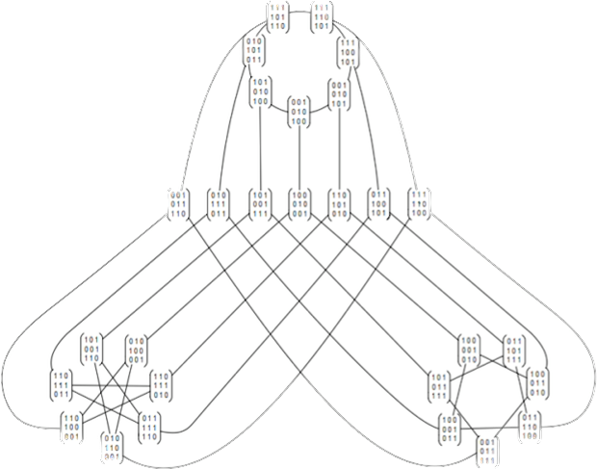

Slide 7
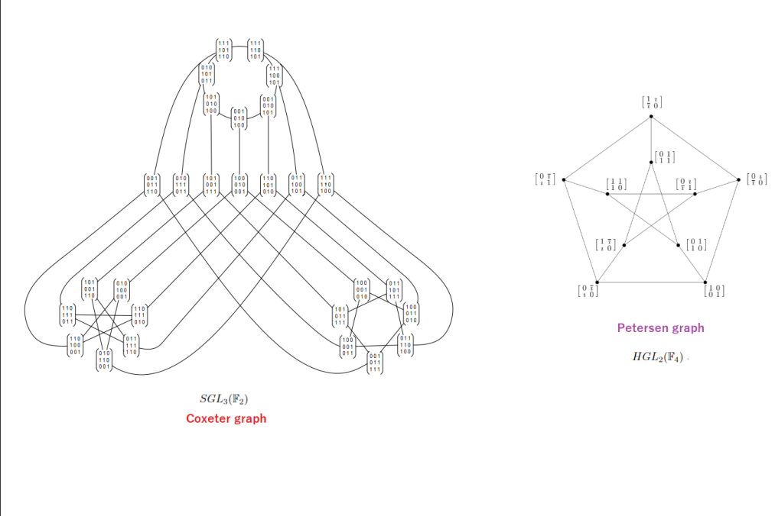

Slide 8
RESEARCH QUESTIONS

Slide 11
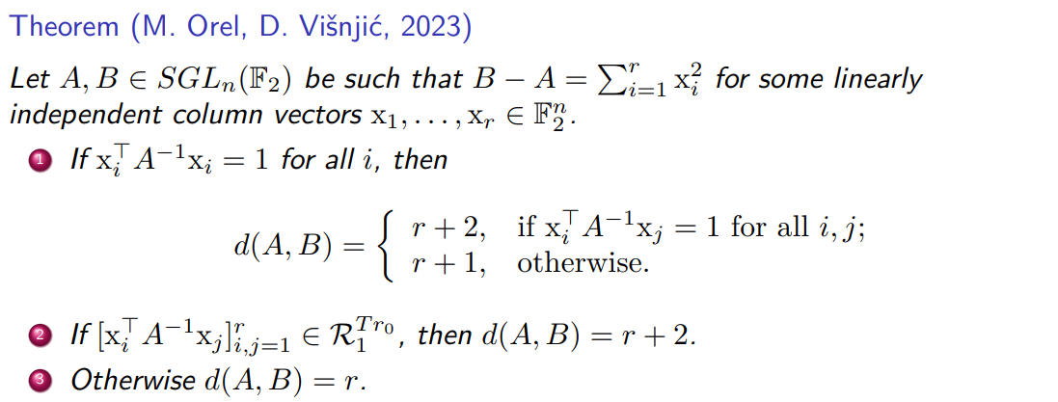

Slide 14
THANK YOU FOR YOUR ATTENTION!

